Slide 1



How to Web Scrape Job Postings on Indeed.com with Python
By David Wasserman

Slide 2

Who Am I and How Did I Get Here?
David Wasserman
Lifelong learner who enjoys applying my education to solving problems
Likes: bad movies, comic book art, and poker
Connect with me:
Email: davidphilipwasserman@gmail.com
LinkedIn: https://www.linkedin.com/in/david-p-wasserman/
GitHub: https://github.com/DPWasserman/

Slide 3
Agenda
Overview of web scraping: What? Why? How?
Scoping out the target: Indeed.com
Running the scraper and code review
Looking at the results and analysis

Slide 4

Overview of Web Scraping
The Internet started as a method to share information. It evolved to much more but it still exists as a data store.
Fundamentally, each page on the Internet on the web is composed of:
Information (most often in HTML format)
Formatting (most often in CSS format)
Interactive Code (most often in JavaScript)
Web scraping is defined as the automated collection of information from web pages

Slide 5
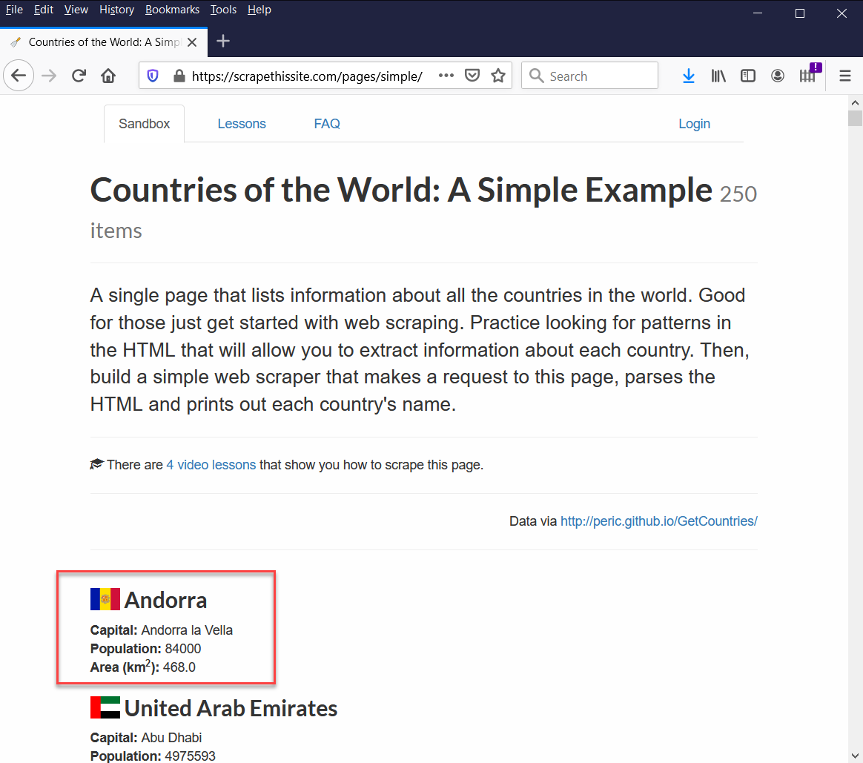
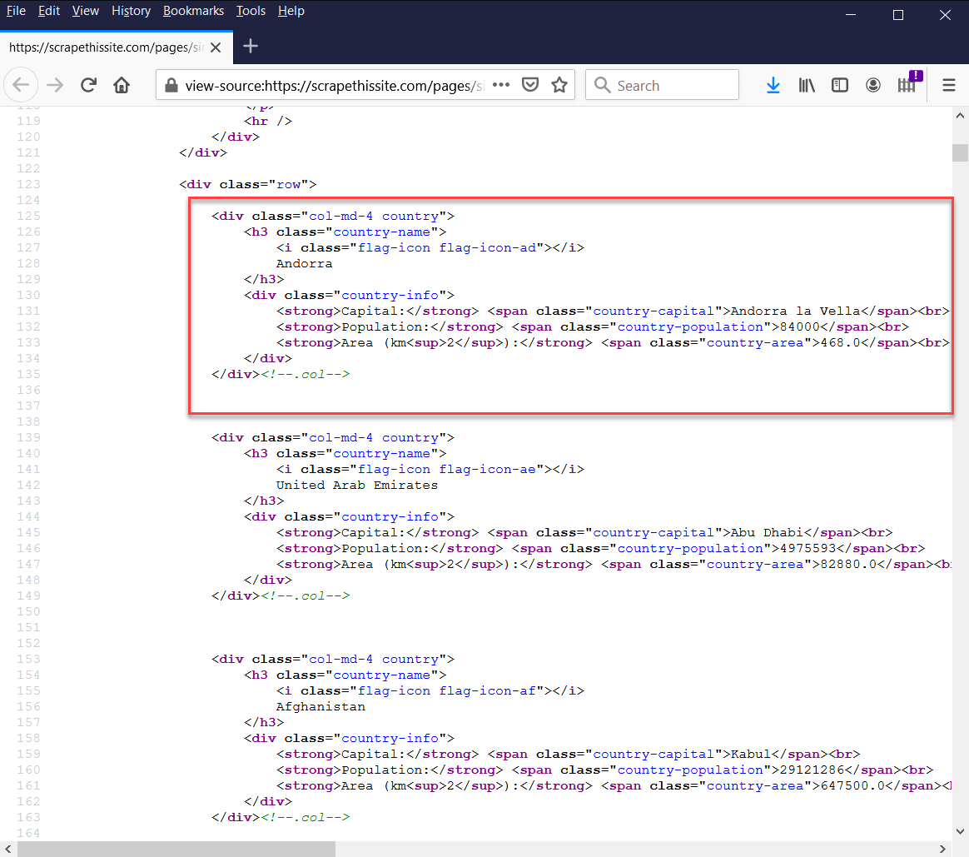
Behind the Scenes of a Web Page

Slide 6

Scoping Out the Target:
Indeed.com is a popular web site used by job seekers and job posters to connect with each other.
Of all the job boards, Indeed.com has the most lenient terms and conditions. Indeed does not require credentials to search its listings.
Indeed offers an API although it is limited when it comes to volume. This made Indeed a good candidate for scraping.

Slide 7
Downloading the Code from GitHub
Choose one of the methods below:
Method 1:
Open a Terminal like an Anaconda Prompt or a Command window
Navigate to a desired location on your hard drive (It is important to keep your storage orderly!)
Type “git clone https://www.github.com/DPWasserman/indeed-jobs”
Method 2:
Navigate to GibHub (https://www.github.com/ DPWasserman/indeed-jobs)
Click the green Code button and press Download ZIP
Unzip the file to a desired location

Slide 8

Project Methodology
Web scraping through Scrapy
Utilized a rotating, anonymous proxy to increase scraping speed
Natural Language Processing of the job postings to create the Word Cloud and the analyses

Slide 9
Configuring the Indeed Scraper
Inside the indeed folder is a file called config.py.
It allows the user to configure three parameters:
The job to be searched (e.g., “data scientist”)
The location(s) to be searched (e.g., New York, NY)
The anonymous proxy which hides my true location (like a VPN)

Slide 10
Running the Indeed Scraper
Once the configurations are set and the file is saved,
Open a Terminal window
Navigate to the folder on your hard drive which houses the project
Type “scrapy crawl indeed_spider –L INFO”
Watch it go! (The results will appear in the newly created data folder as indeed_spider.csv)

Slide 11
Repository Layout
indeed folder → Where the Scrapy code resides
data folder → Created by the Scrapy code to house the results
ipynb files → Jupyter Notebooks that analyze the results in the data folder

Slide 12
About Me
Email: davidphilipwasserman@gmail.com
LinkedIn: https://www.linkedin.com/in/david-p-wasserman/
GitHub Repository: https://www.github.com/DPWasserman/indeed-jobs
Blog: https://nycdatascience.com/blog/author/david-wasserman/

Slide 13
Appendices

Slide 14
Installing the Project
Create a virtual environment:
python –m venv <environment_name>
Activate the virtual environment
On Windows: .\<environment_name>\Scripts\activate
On MacOS/Linux: source <environment_name>/bin/activate
Navigate to the project folder
Install the project dependencies into the virtual environment:
pip install -r requirements.txt
Run the scraper:
scrapy crawl indeed_spider -L INFO

Slide 15
Background
To install Scrapy, open a Terminal window and type “pip install scrapy”. Note that it is preferable to install into its own virtual environment.
To initialize a Scrapy project, open a Terminal window and navigate to a desirable location.
Type “scrapy startproject <project_name>” to create the scrapy project
Type “cd <project_name>” to navigate into the new project folder
Type “scrapy genspider <spider_name> <starting_URL>” to generate your first crawler

Slide 16
Appendix: Sample Analysis

Slide 17
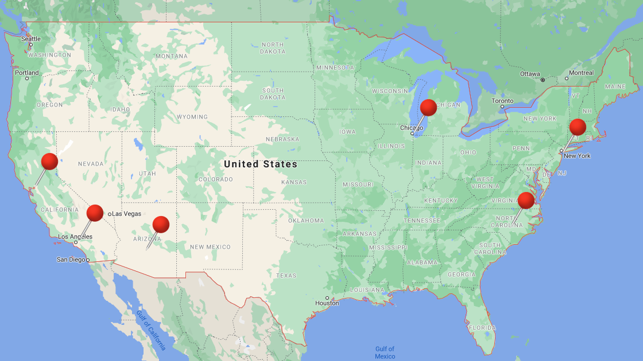
Cities Analyzed
Charlotte, NC
Chicago, IL
Los Angeles, CA
New York, NY
Phoenix, AZ
San Francisco, CA

Slide 18
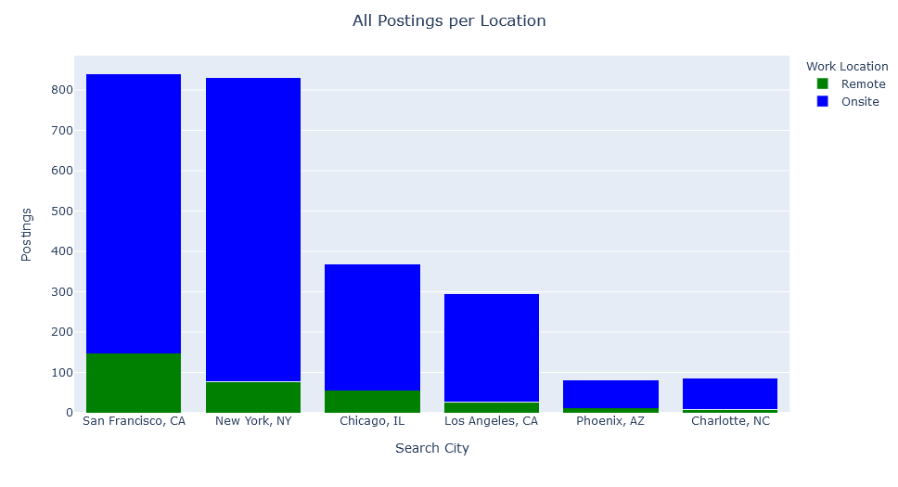
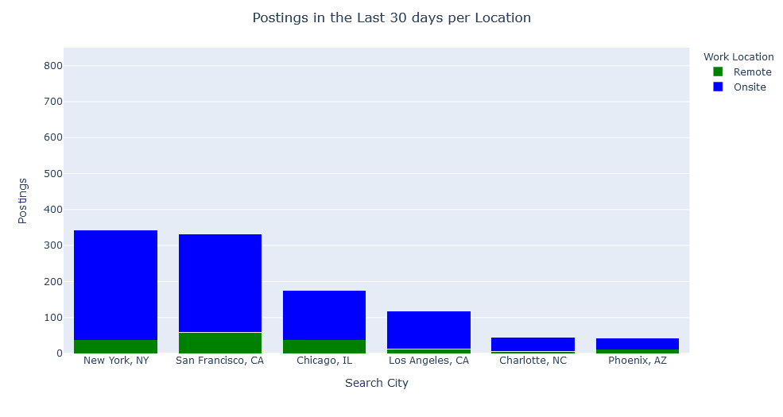
Statistics for the Search Locations

Slide 19
Statistics for the Search Locations
All Data Science Jobs on Indeed
Data Science Jobs Posted in the Last 30 Days
Search City | On Site | Remote | Total
Charlotte, NC | 77 | 8 | 85
Chicago, IL | 314 | 55 | 369
Los Angeles, CA | 269 | 27 | 269
New York, NY | 754 | 77 | 831
Phoenix, AZ | 69 | 11 | 80
San Francisco, CA | 694 | 147 | 841
GRAND TOTAL | 2,177 | 325 | 2,502
Search City | On Site | Remote | Total
Charlotte, NC | 40 | 5 | 45
Chicago, IL | 137 | 37 | 174
Los Angeles, CA | 106 | 12 | 118
New York, NY | 306 | 37 | 343
Phoenix, AZ | 31 | 11 | 42
San Francisco, CA | 273 | 59 | 332
GRAND TOTAL | 893 | 161 | 1,054

Slide 20
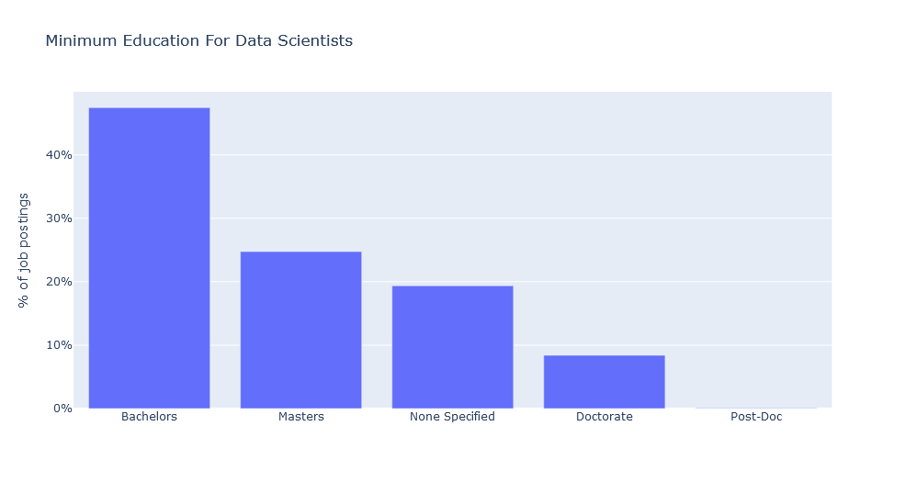
Minimum Education

Slide 21
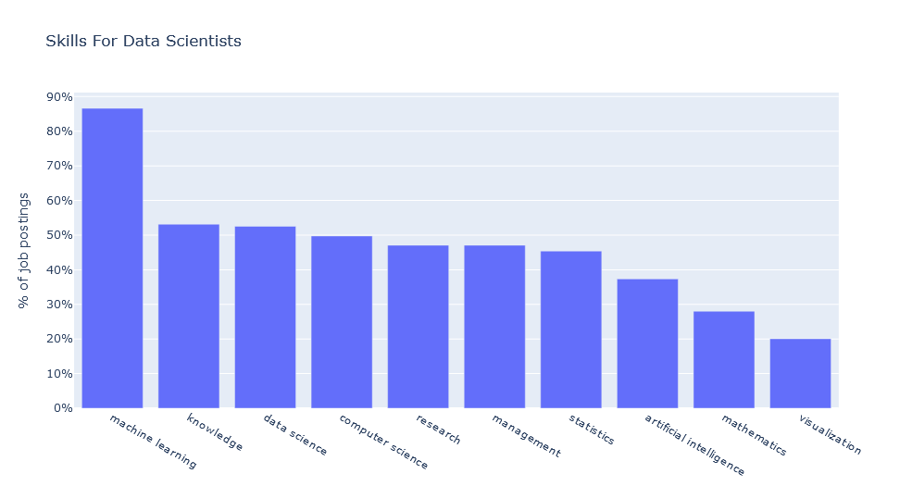
Broad-Based Skills in Demand
Other Popular Skills (in order)
Optimization
Natural Language Processing
Deep Learning
Recommendations
Business Intelligence
Data Mining
Regression
Classification
Forecasting
Neural Network

Slide 22
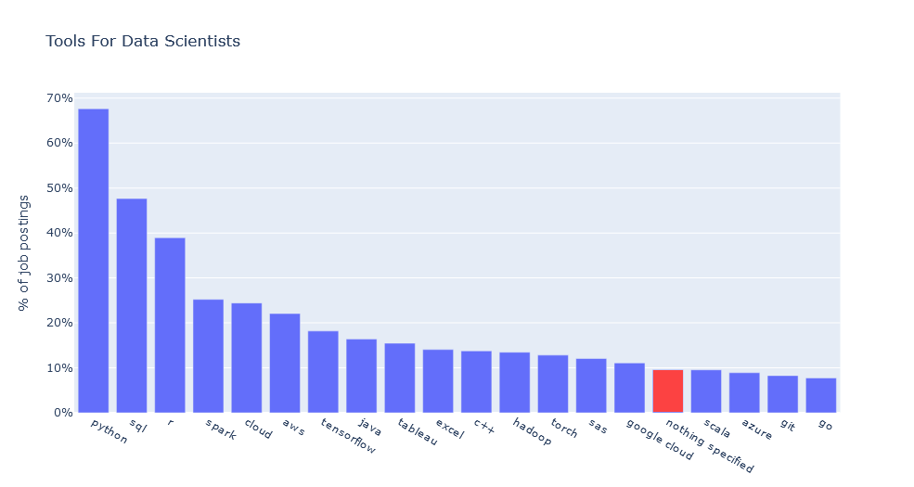
Specific Technologies in Demand

Slide 23
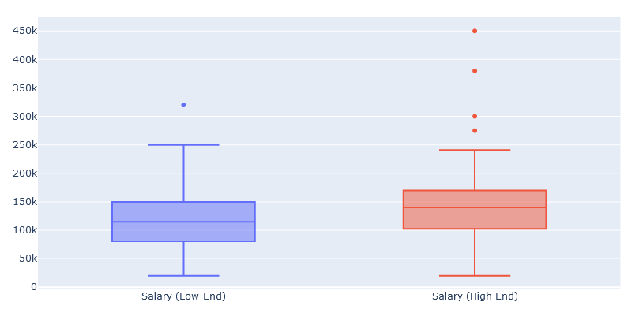
Salary Information
Metric | Annual Salary (Low End) | Annual Salary (High End)
Mean | $115,621 | $145,044
Minimum | $20,000 | $20,000
25% | $80,750 | $103,309
50% | $114,700 | $140,000
75% | $150,000 | $170,000
Maximum | $320,000 | $450,000
n=97 out of 2,502

Slide 24
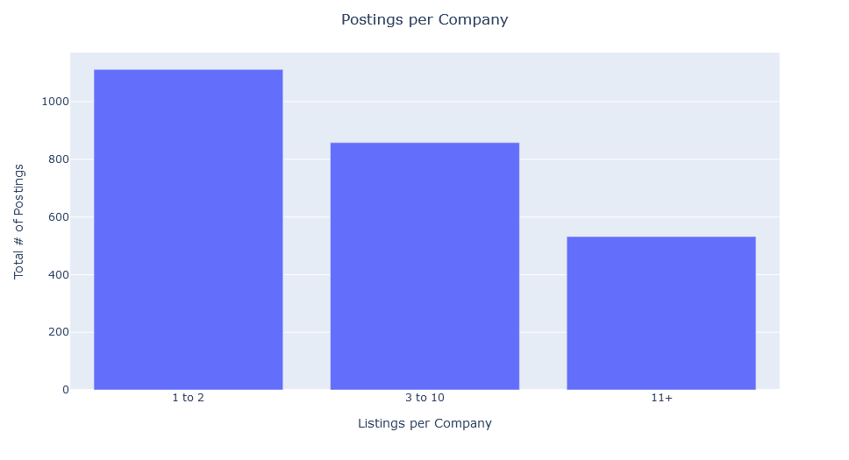
Companies Hiring Data Scientists
# | Company Name | # of Postings
1 | Deloitte | 71
2 | Facebook | 64
3 | Twitter | 31
4 | Uber | 30
5 | Spotify | 28
6 | Accenture | 28
7 | KPMG | 26
8 | Amazon.com Services LLC | 22
9 | Wells Fargo | 21
10 | Bloomberg | 19
There are 1,130 unique companies; 730 have only 1 posting, 321 postings come from companies posting 20 or more posts.

Slide 25
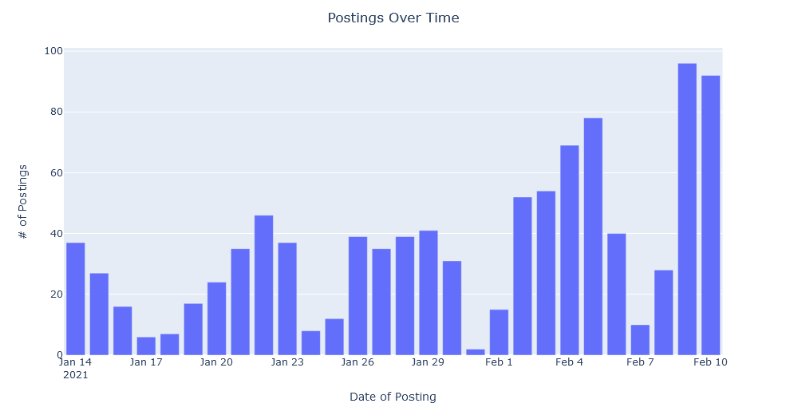
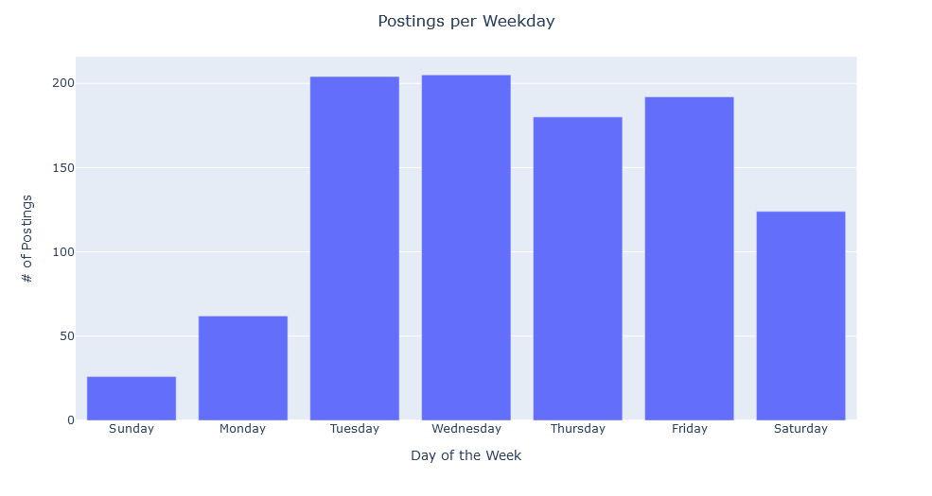
Best Days to Look for a Position
Tuesday and Wednesday have the most postings

